Slide 1
Bill Generation
A quick explanation of how the design would work.

Slide 2
Places To Pull data from
So the first and most apparent is User State. This is the guest checkout system if they click 1st game link primary key 1 gets sent to a JS list in the users memory, and then snag it back up at checkout doesn’t require an account.
Account based checkout. The above-Mentioned Technique would not work for use cases where the user wants to keep a list of Christmas presents shopped over a period of a couple days. For these we can send SQL inserts through PHP to a rest API that will store the users Cart info into a Cart/Cart Items table.

Slide 3
How to use that to generate a bill.
Well the first technique from the last slide. That of tracking user state. For obvious reasons is the most simple you take the PK’s query the table through php on rest get the price multiply it by amount and plug that into PayPal. The Next is a little more treacherous.
I will need to take whatever the users Unique UserId is query that against the cart query the cart against the cart Items and finally get a list of games purchases. Sum the columns and then send that back to the PayPal API via PHP/Rest API.

Slide 4
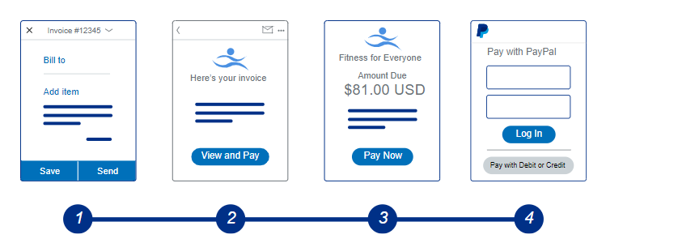
The Invoice
I'm a lucky man today because PayPal of course has built in all the tools necessary to do the invoice, given I've provided the information through required automated of course.

Slide 5
BOTTOM TEXT TOP TEXT
That’s it thank you ☺

